Slide 1
Team USA Olympic medal strategy
Presented by
Andres Principe and Tammy Pham

Slide 2
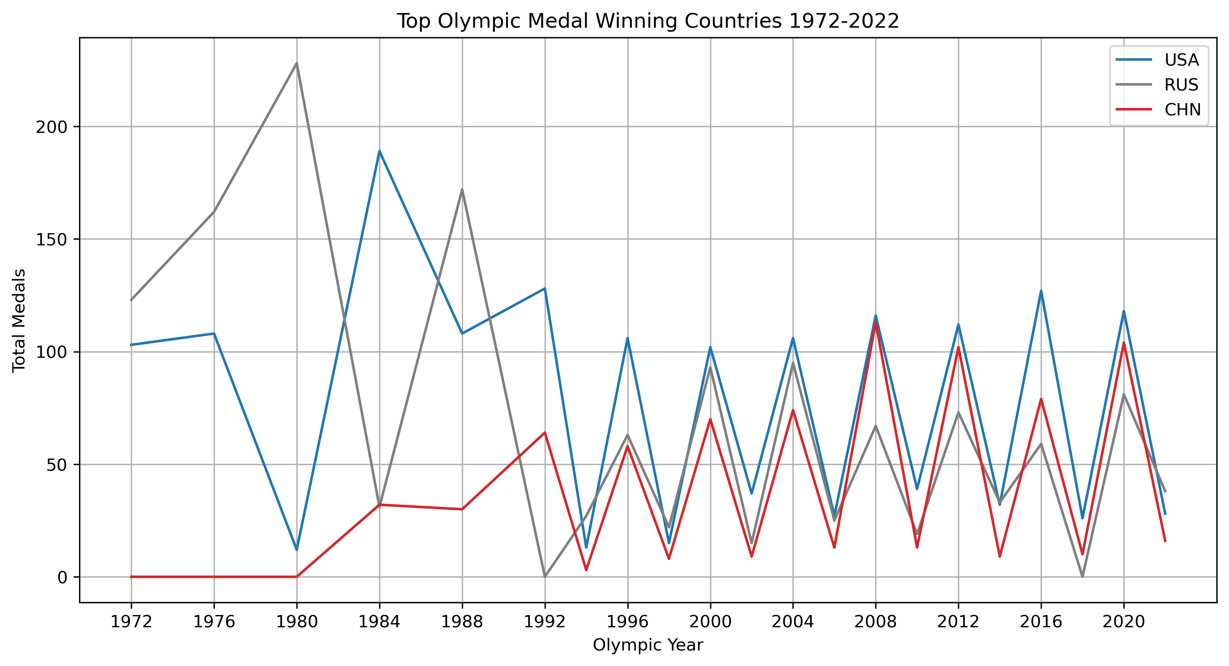



Team USA's medal advantage and how secure is its position at the top?
Source: Kaggle - Olympic Summer & Winter Games, 1896-2022, Olympics.com
Notes:
Highly competitive, USA always has the most medals but the margin between second place is narrow

Slide 3
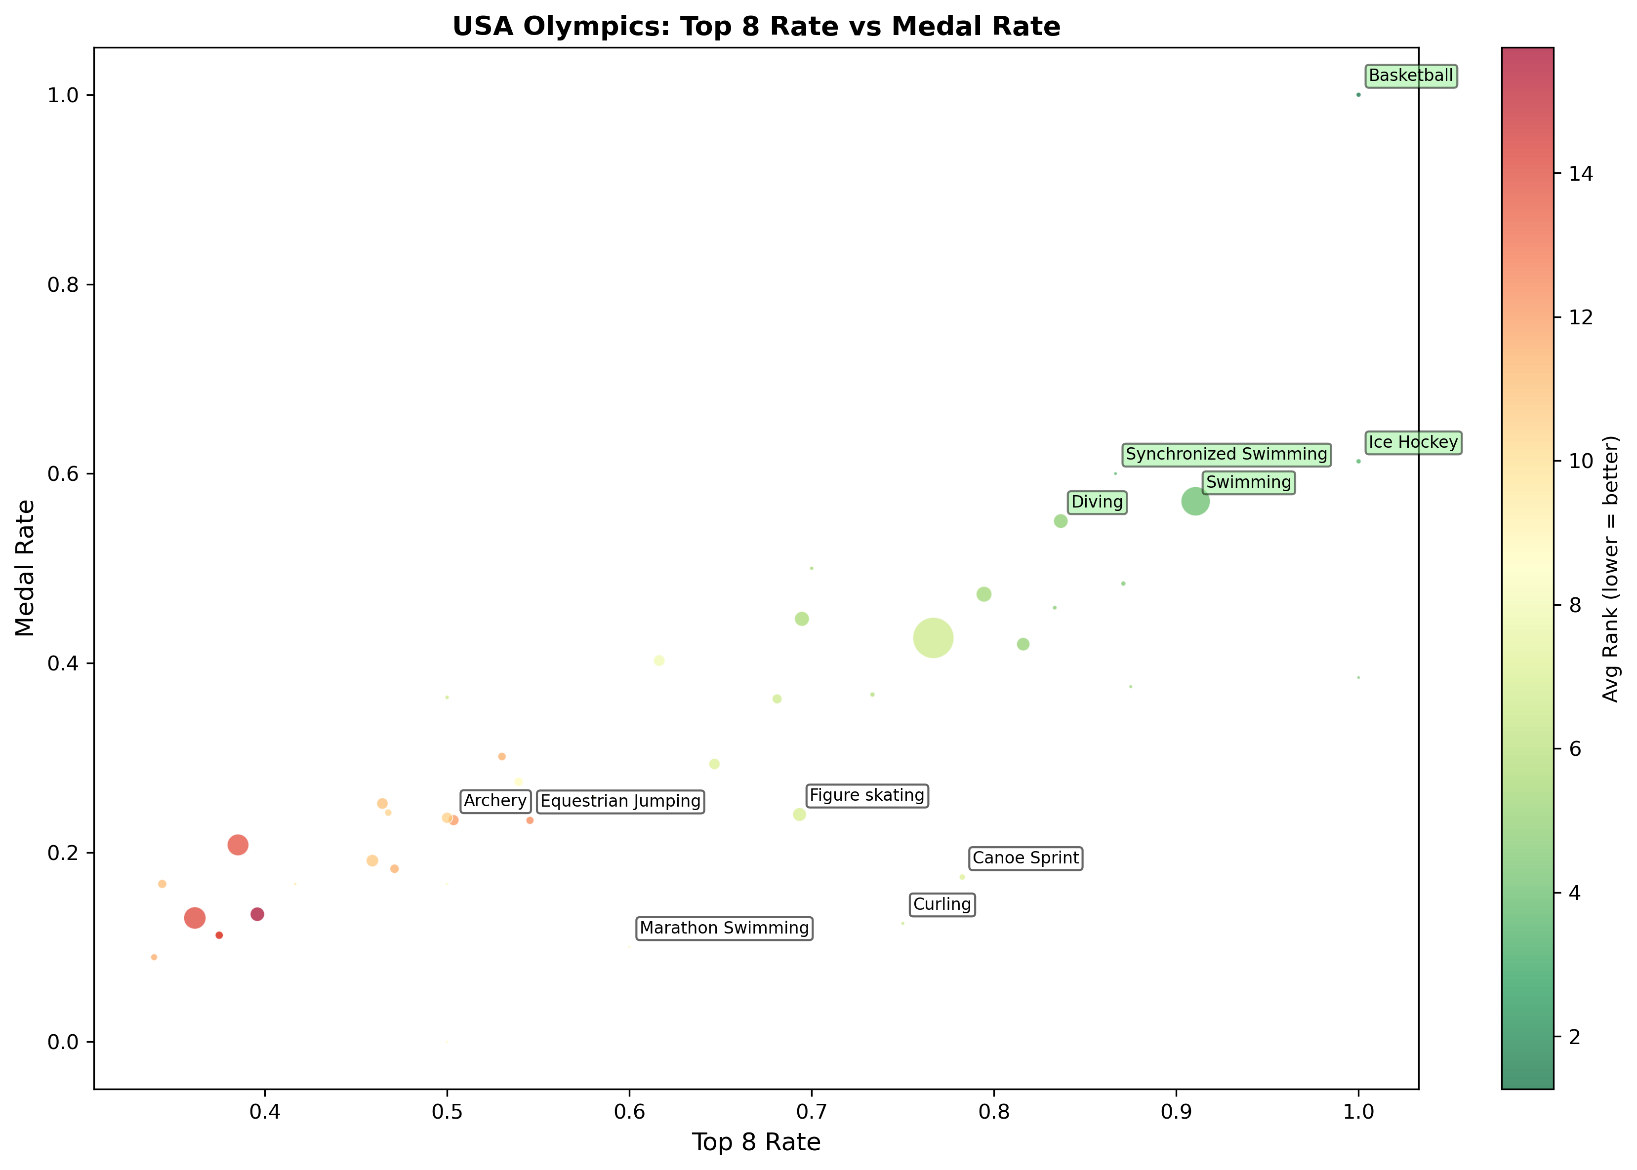
High ranking events for team usa
Source: Kaggle - Olympic Summer & Winter Games, 1896-2022, Olympics.com
Notes:
Olympic result data since 1924

Slide 4
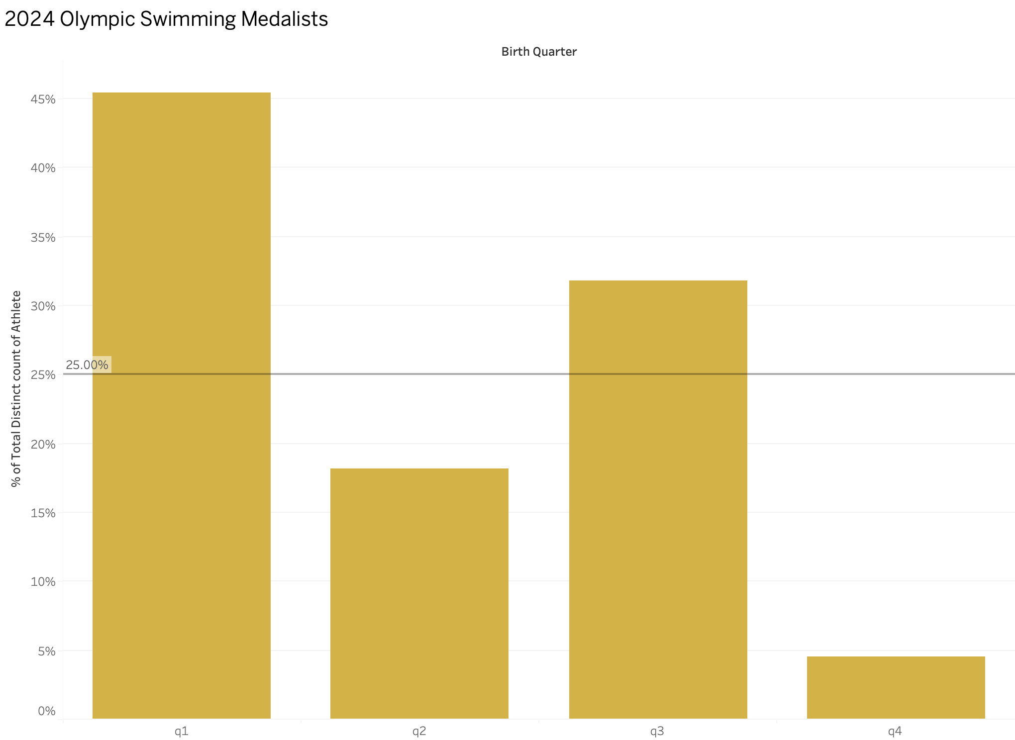
Relative Age Effect
Over 45% of 2024 Olympic Swimming Medalists are born in q1
What other features can be attributed to competitive success?
Source: Wikipedia - Swimming at the 2024 Summer Olympics, Kaggle - Olympic Summer & Winter Games, 1896-2022, Olympics.com
Notes:
Selection bias as the cut off period within a year favors the older kids of the year so there are more professional athletes born in Q1

Slide 5
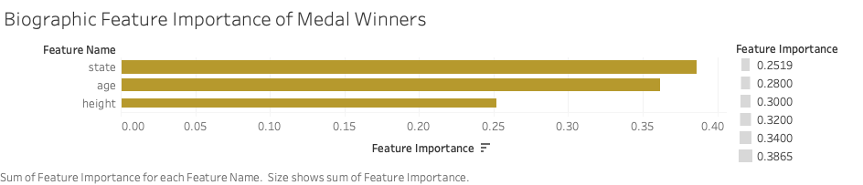
What makes a medal winner?
Random Forest Classification
Trained to predict whether-or-not a USA athlete has medaled
Uses all available athlete biographic data at teamusa.com

Slide 6
Using Home States FOr Graph Representation Of Olympic EVENTs
Graph Construction
Node: An event won by an individual
Edge: The shared home state of the individuals who won separate events.
Weights: Summed medal values
Gold = 3
Silver = 2
Bronze = 1
State
Event A
Event B

Slide 7
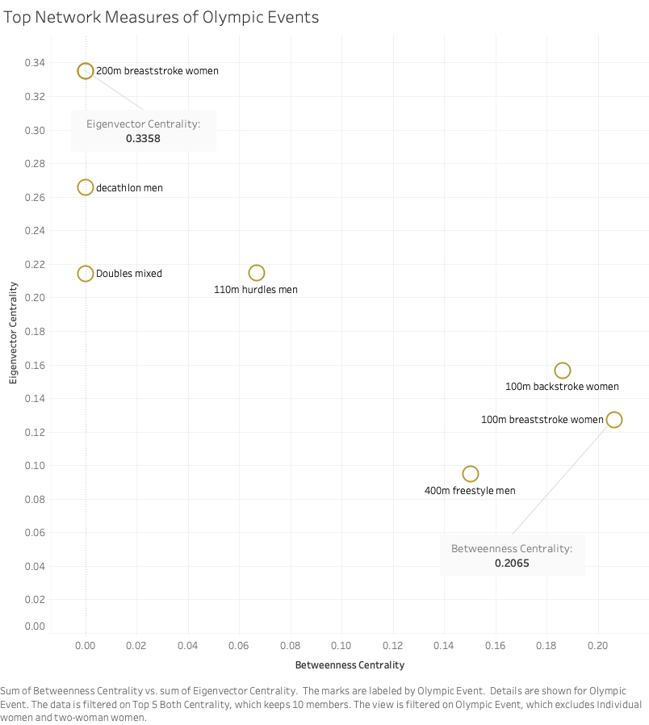
Network Centrality Measures For Events
Eigenvector Centrality: Values higher medal rank.
Betweenness Centrality: Values lower medal rank, but more connected to different events

Slide 8
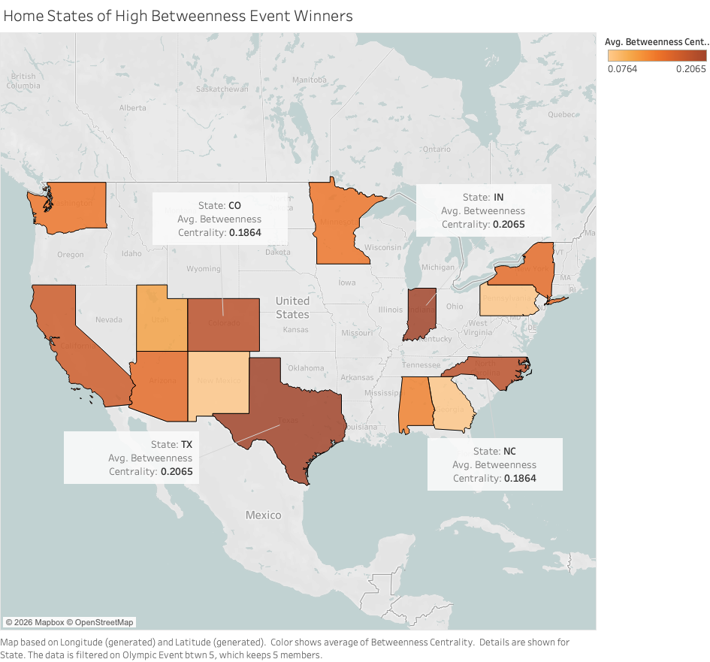
HomE States With high Event Betweenness
Colorado
Indiana
North Carolina
Texas

Slide 9
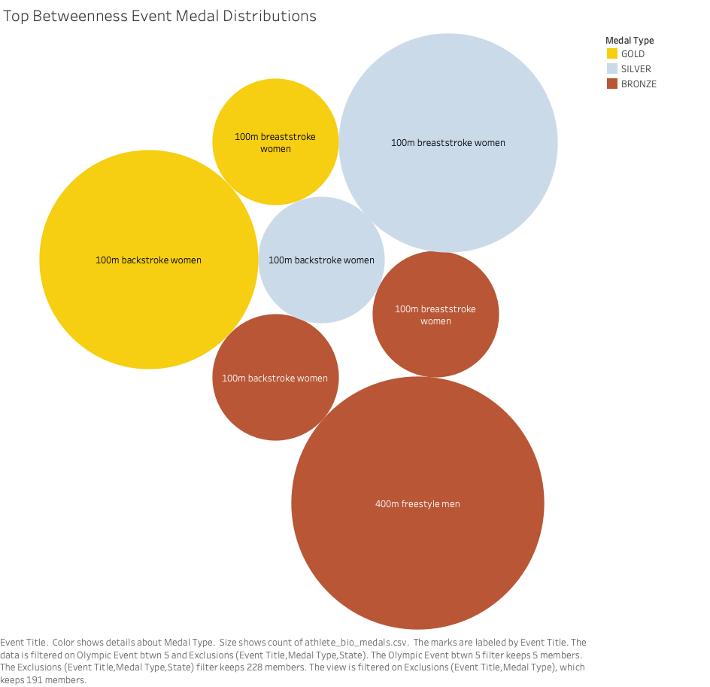
Medal DISTRIBUTION For HIGH BETWEENNESS EVENTS

Slide 10
Investing Recommendations
Invest In the Midwest. Specifically states like Colorado & Indiana
Don't forget about women's aquatic sports!
Age is just a number… until you’re selecting an Olympic team

Slide 11


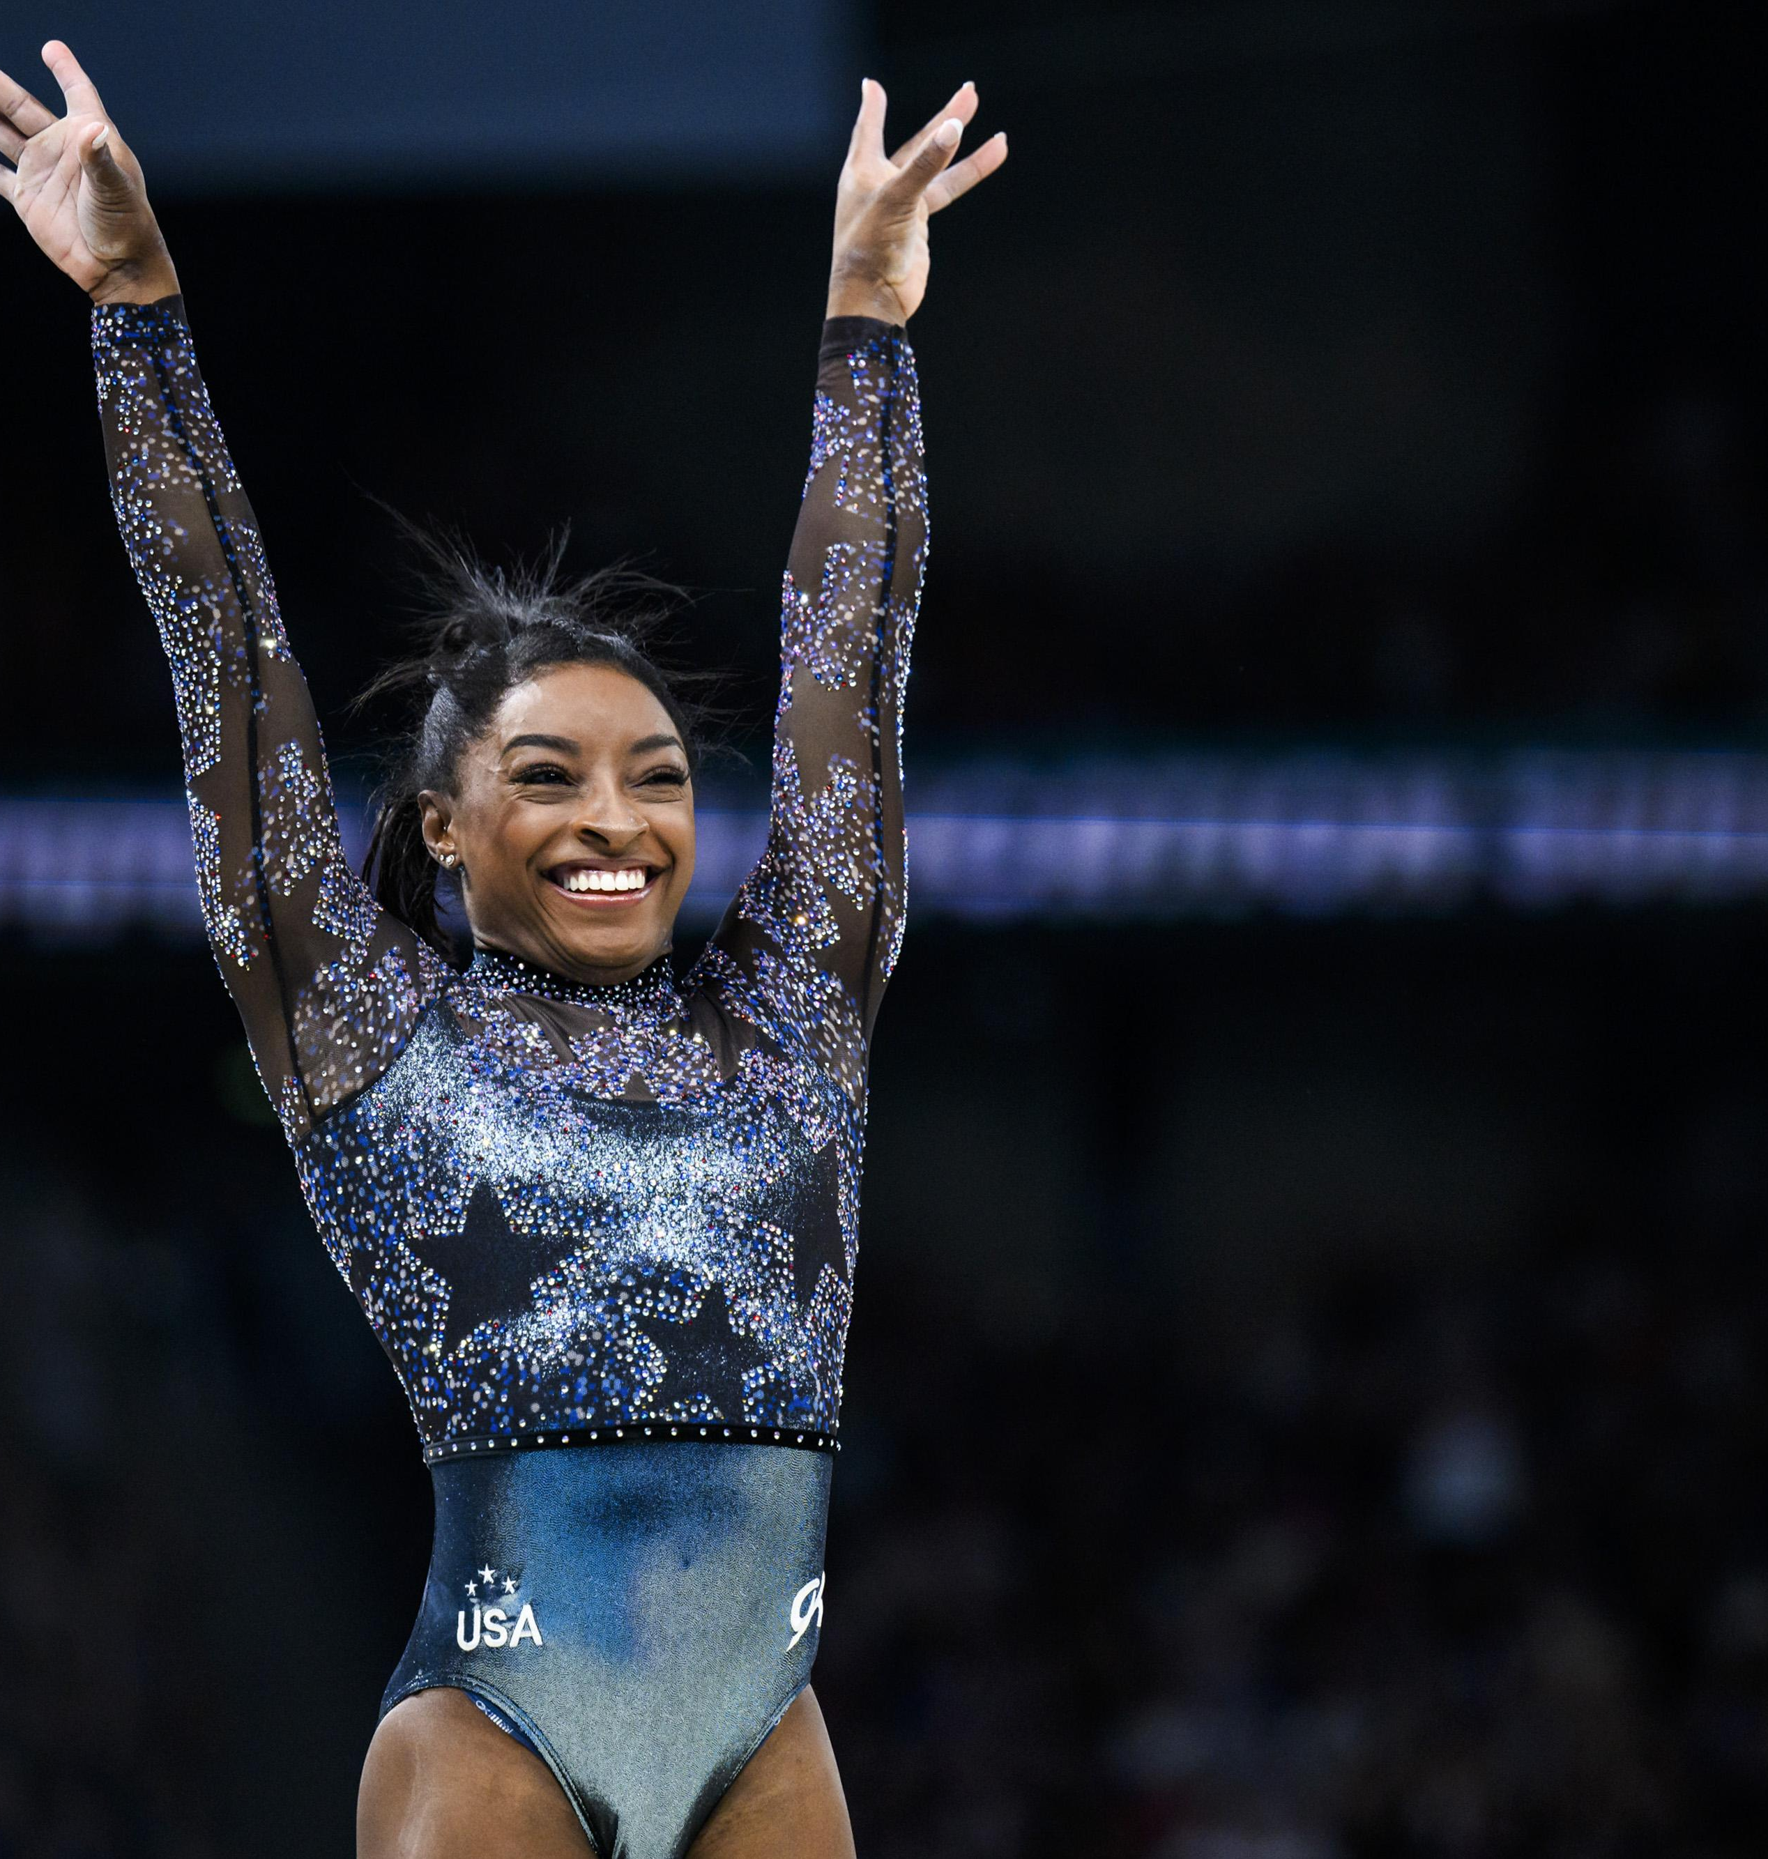
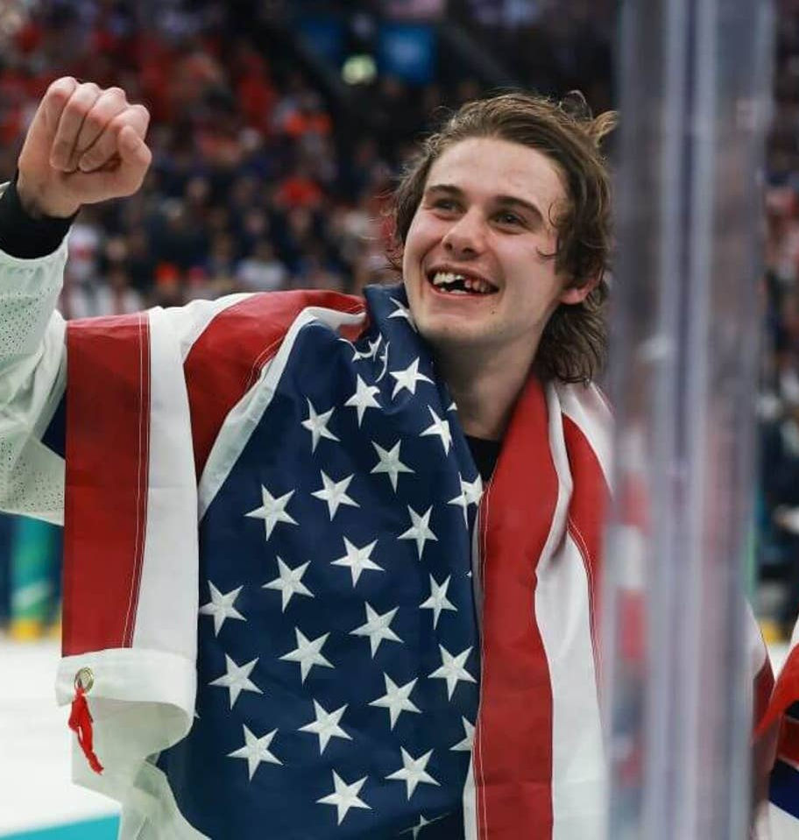

Creating household names to increase sponsorship
Notes:
Jack Hughes and Simone Biles
Why should you care? Investing in more/different sports to inspire youth development and create bigger communities, creates more competition and training technological enhancements, higher chance of discovering elite talent, gives kids access to better fitness and healthy habits

